Slide 1
Cardiovascular Risk Prediction
A Project By:
Aditya Raikwar

Slide 2





Project at a glance
Problem statement
Data structure
Exploratory data analysis
Models and evaluation
Final thoughts
About the task and modelling
Structure of dataset along with basic dictionary.
EDA along with visualization.
About the models used for prediction along with metrics to evaluate.
Final outcomes and Prediction Results.

Slide 3
Problem Statement
Unfortunately we are seeing a hefty rise in the cases of Coronary Heart Diseases recently, it could be due to lifestyle habits like- lack of exercise, increasing work pressure, Smoking, Diabetes, Blood Pressure etc. because of which it has become more important now to do regular self checkups and visits to the hospitals so as to make the chances of these diseases lesser and therefore as Data Scientists it is now more important for us to design some precautionary methods so that these checkups can provide a more insightful prediction about a person’s health. In this project I am trying to predict the Risk of Coronary Heart Disease in the upcoming 10 years for a person using the available data.

Slide 4
Data structure
The Data Contains –
16 Columns
&
3390 Rows

Slide 5
Data dictionary basics
The data contains 16 columns which can be subcategorized as the following:
Demographic Data:
This data contains columns –
Sex
Age
Behavioural Data:
Is_smoking – tells about if a person is smoker or not
CigsPerDay
Medical History:
BPMeds – taking BP medications or not
PrevalentStroke – has a person suffered a stroke before
PrevalentHyp – does a person have hypertension
Diabetes

Slide 6
Data dictionary basics
Current Medical Conditions:
TotChol – Total Cholesterol level (HDL + LDL)
SysBP - Systolic Blood Pressure
DiaBP – Diastolic Blood Pressure
Glucose – Glucose level in blood
BMI – Body Mass Index
HeartRate
Target Variable - TenYearCHD

Slide 7
Exploratory Data Analysis
Missing Values :
Some columns contained the missing value, which were handled by replacing them with mean/median after careful consideration.
The column BPMeds contained 44 missing values, but this column tells us that whether a person is on BP medication or not, so to fill them with any number is not safe as we can not assume about the medications of a person. That’s why I dropped these values.
Duplicates:
No duplicate values were found in the data.

Slide 8
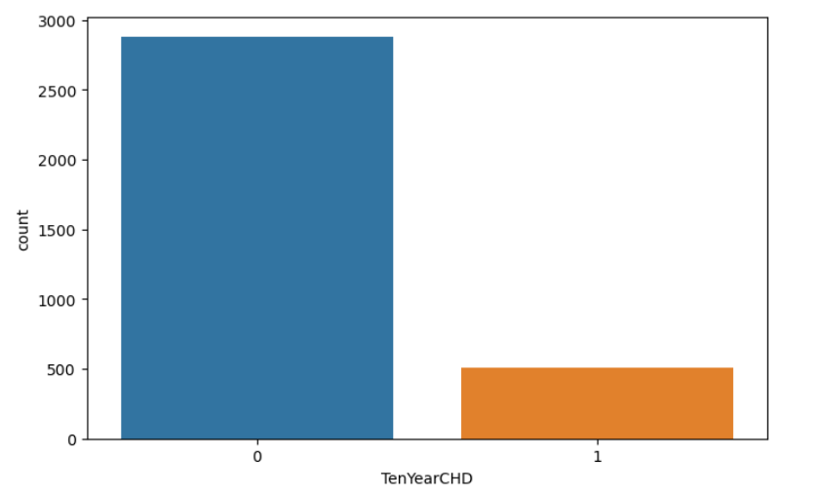
EDA visualization
Here The count of target variable can be seen.
We can see the data contains dominant values of negative cases and comparatively less positive cases.

Slide 9
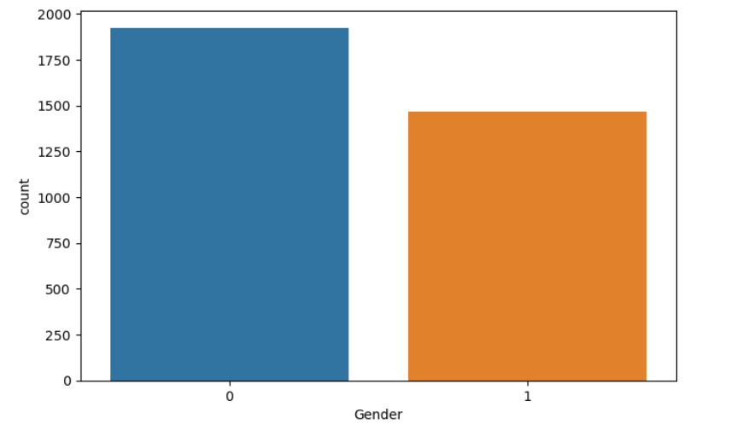
EDA visualization
Here The count of Gender can be seen.
Ratio of Male and Female in the data can be considered good.

Slide 10
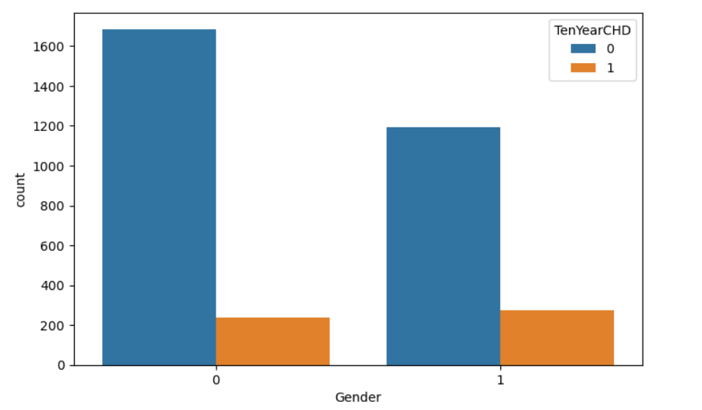
EDA visualization
The count of target variable with respect to Gender can be seen in this graph.
We can see that ratio of males getting the coronary heart disease is greater than that of females.

Slide 11
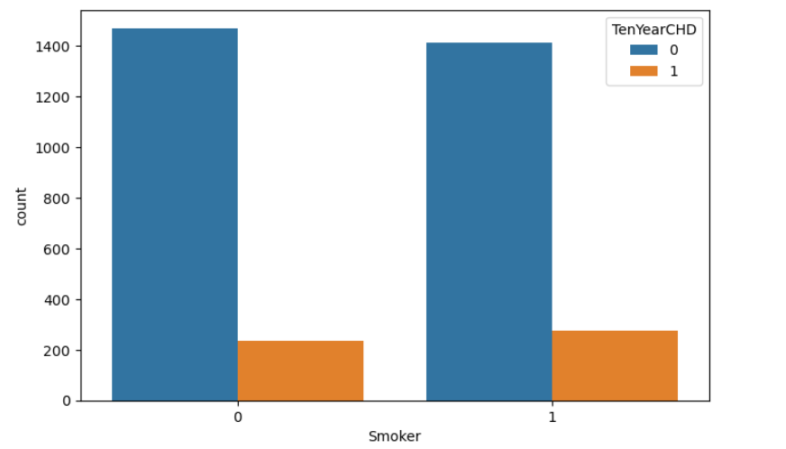
EDA visualization
The effect of smoking on the coronary disease can be seen in this graph.
This graph is not a significant indicator as we can see the disease is equally affecting the smokers as well as non-smokers.

Slide 12
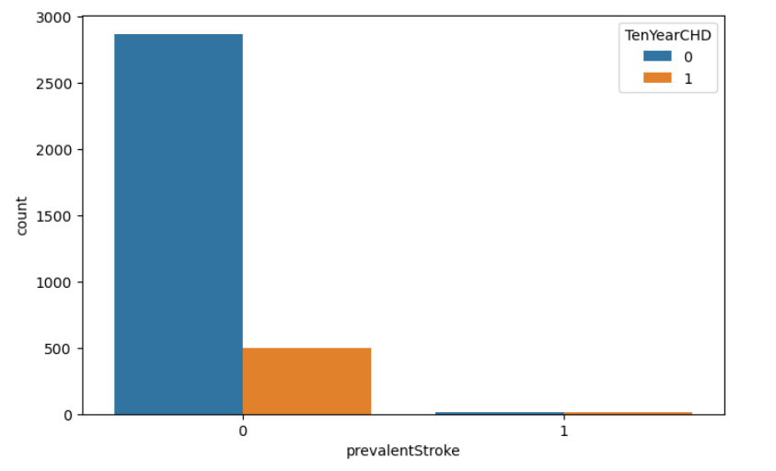
EDA visualization
Target variable with respect to prevalent stroke
Here we can see that people who earlier suffered a stroke (although very less in numbers) experienced the CHD which is obvious.

Slide 13
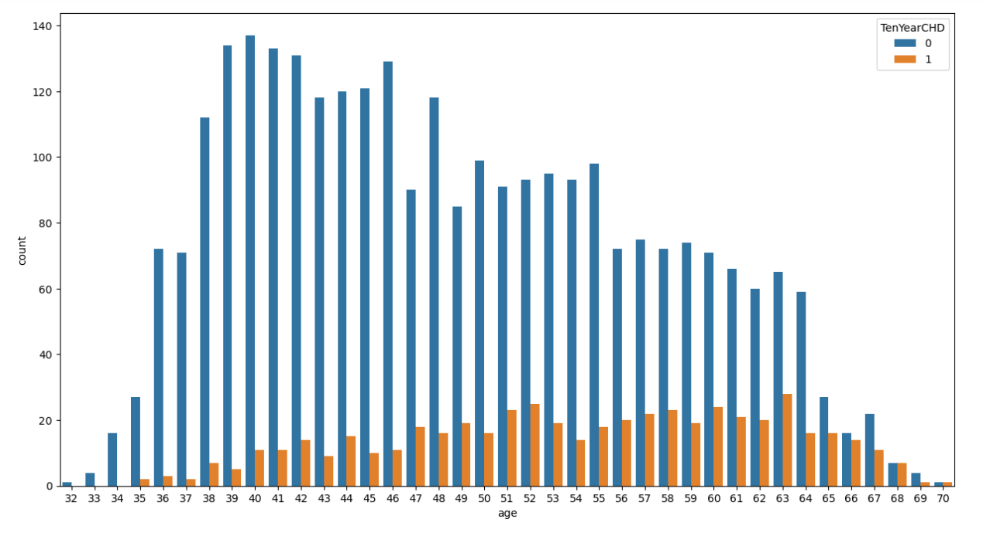
EDA visualization
Effect of age on the CHD can be seen here
The people from age group 55 to 70 has the highest ratio of CHD, which means a person of age 55 and above should take precautions and should do regular checkups.

Slide 14
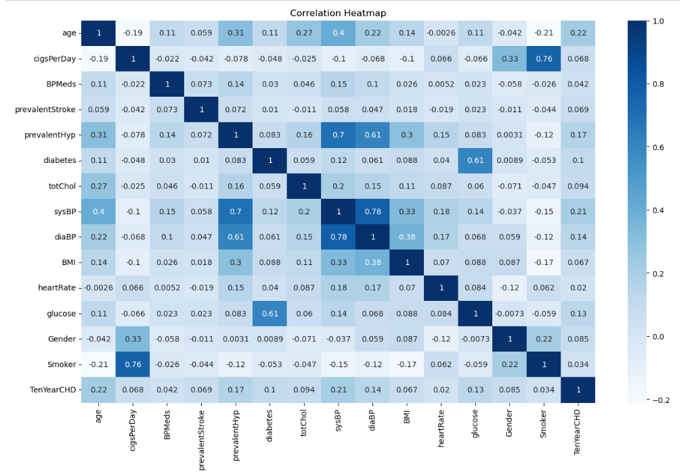
Correlation visualization
Here we can see that the columns – Smoker is highly correlated with cigPerDay.
Diabetes and glucose level go hand in hand which is clear from this correlation graph.
Systolic blood pressure and Diastolic blood pressure are also highly correlated because of obvious reasons

Slide 15
EDA Summary
We can say that we have a unbalanced dataset which could pose a problem during prediction.
We saw various factors which could contribute to the leading of the disease, but it can not be said that any of them individually have a concrete basis for the outcome. Which was confirmed using correlation plot.

Slide 16
Models and metrics
MODELS :
Logistic Regression
Decision Tree Classifier
Random Forest Classifier
EVALUATION METRICS :
Accuracy Score
Confusion Matrix
Classification Report

Slide 17
Model accuracy
Logistic Regression
Decision Tree Classifier
Random Forest classifier
Accuracy Score: 83.48
Accuracy Score: 82.30
Accuracy Score : 86.13
All the models are showing accuracy above 80% but this alone is not the evaluation metric. Let’s discuss it during presentation in depth.

Slide 18
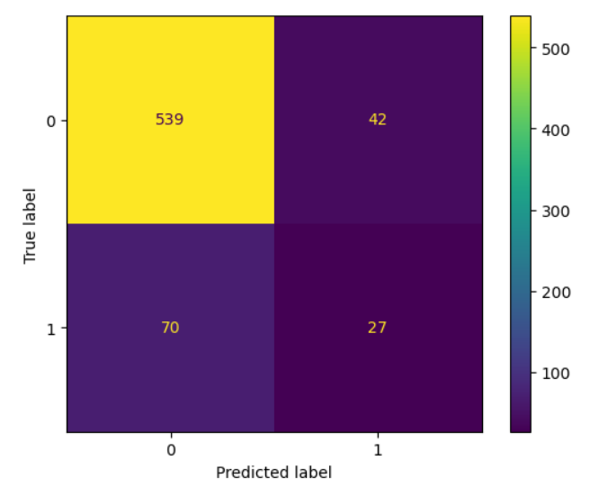
Confusion matrix:
Logistic regression

Slide 19
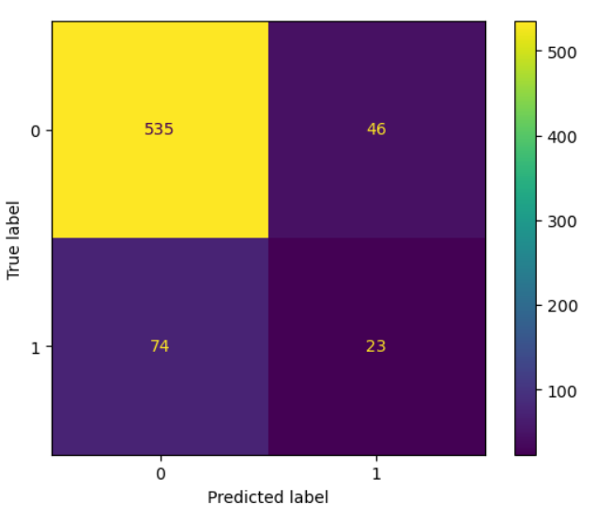
Confusion matrix:
Decision tree classifier

Slide 20
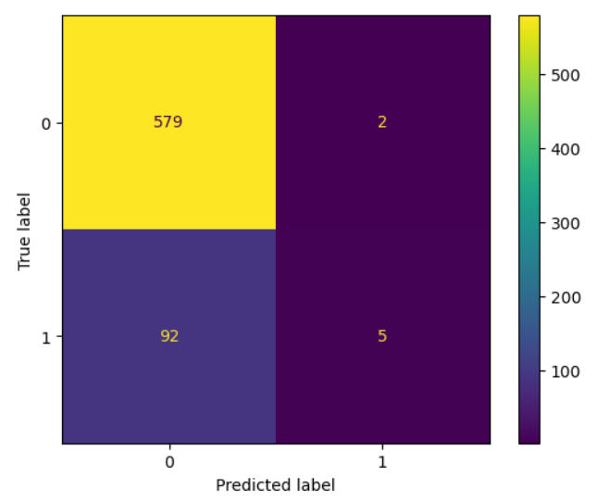
Confusion matrix:
Random forest classifier

Slide 21
SUMMARY
After discussing about the outcomes and in-depth evaluating the models it can be said that the Logistic Regression Model is performing better than the rest.
Although the accuracy of our model is more than 80% (which is impressive) but our model is still not able to predict the True positive very efficiently because of less occurrences of positive target values in our training data.
Our model still seems immature as it is in present state, if we get a chance to get hold of more data we can make a much more accurate model.

Slide 22
THANK YOU
A Project By:
Aditya Raikwar

